Slide 1
History of R
Steve Simon

Slide 2
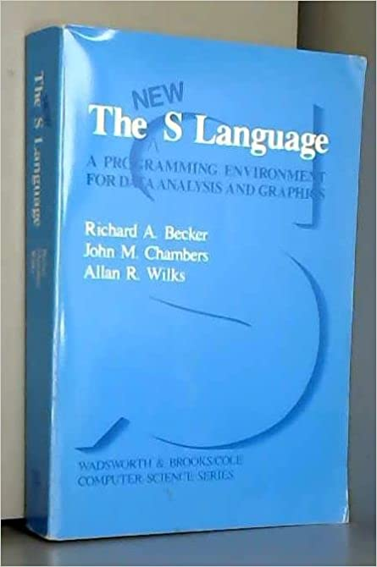
R sprouted from S
Figure 1. Book cover
Notes:
I’m helping to put together three separate classes, Basic data management and analysis with R, SAS, SPSS. As part of these classes, I need to discuss the history of these programs, because understanding that history will help you better understand the strengths and weaknesses of each statistical package. Here’s a brief history of R.
R has its roots in a program called S. S was developed in a time when single letters were in vogue (as in the C programming language).
Image source: Amazon

Slide 3

John Chambers
Figure 2. Photo of John Chambers
Notes:
The primary author of the S language was John Chambers. Often he gets sole credit, there were two other major contributors.
Image source: AT&T

Slide 4

Richard Becker
Figure 3. Photo of Richard Becker
Notes:
Also involved with S, is another statistician, Richard Becker.
Image source: AT&T

Slide 5

Allan Wilks
Figure 4. Photo of Allan Wilks
Notes:
A third author was Allan Wilks.
Image source: AT&T

Slide 6
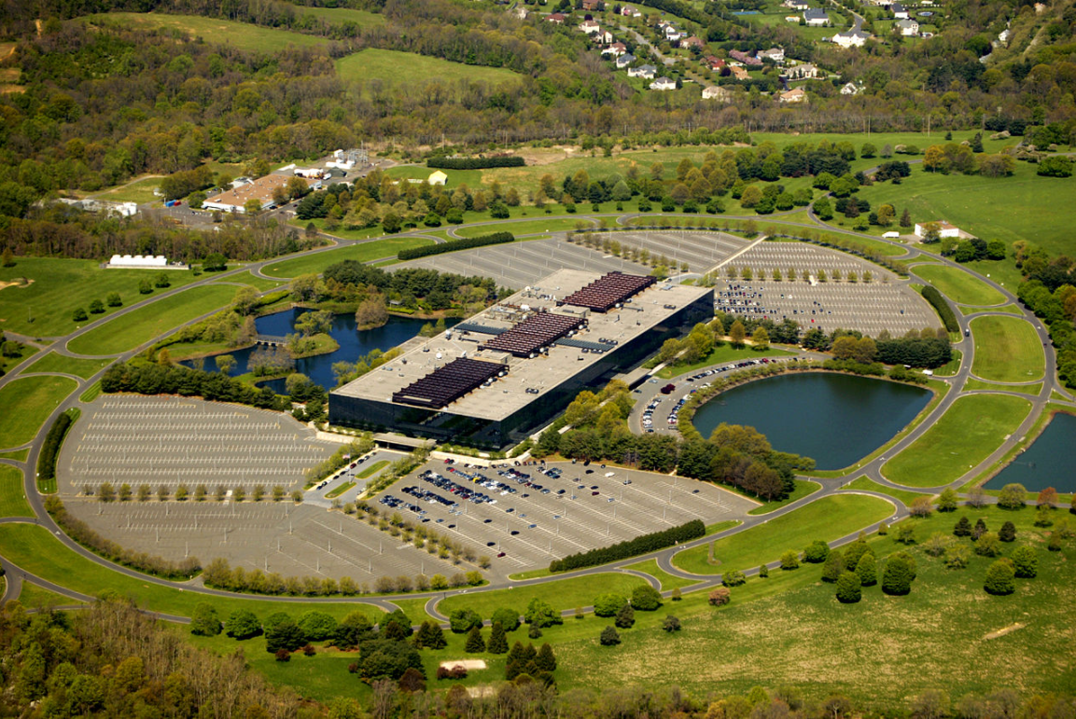
Bell Labs
Figure 5. Aerial photograph of Bell Laboratories
Notes:
All three statisticians worked at Bell Labs. Bell Labs was a research division of AT&T (affectionately known as Ma Bell), back when Ma Bell held a monopoly over telephone service.
Image source: Wikipedia

Slide 7
Features of S.
Intended for internal use.
Freely available to anyone.
Interactive
Unique capabilities
Emphasis on functions
Object-oriented features
Notes:
The author of S, John Chambers, was a statistician at Bell Laboratories wrote several versions in the 1970s through the 1990s. This packages was intended for internal research use, but the code was freely available to anyone who was interested.
S was an interactive programming language, which made it quite different from other statistical software systems of the times, like SAS and SPSS.
Two unique features of the S programming language were the use of functions rather than macros for extending the language and the introduction of object oriented features (classes, objects, and methods).

Slide 8

S-plus
Figure 6. Venables and Ripley book cover
Notes:
A commercial adaptation of S was introduced by Statistical Sciences Corporation in the 1990s and became very popular. Through various mergers and buyouts, S+ has been marketed by Mathsoft, Insightful Software, and more recently Tibco Corporation.
Image source: Amazon

Slide 9
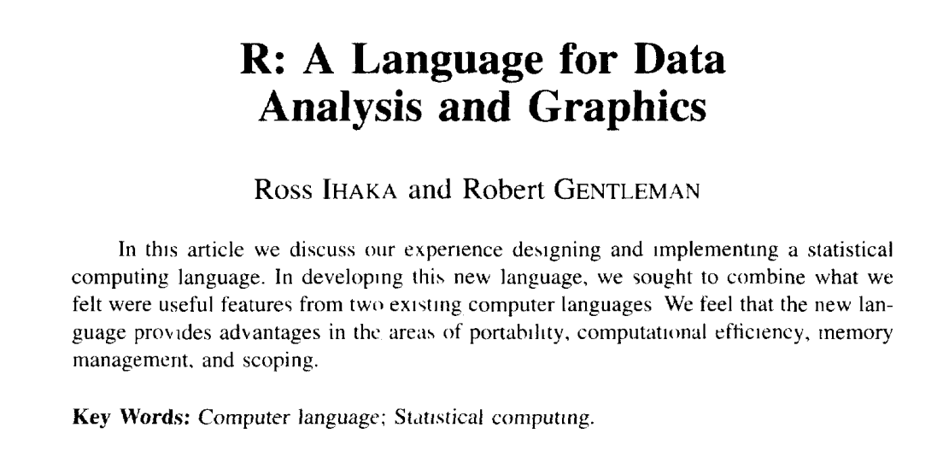
Beginnings of R (1/2)
Figure 7. Excerpt from research paper
Notes:
About the same time, Ross Ihaka and Robert Gentleman started an effort to produce an open source and freely distributed version of S, called R. Their publication:
Ross Ihaka and Robert Gentleman. R: A language for data analysis and graphics. Journal of Computational and Graphical Statistics, 5(3):299-314, 1996. Available in pdf format.
outlined the features of the R programming language.

Slide 10
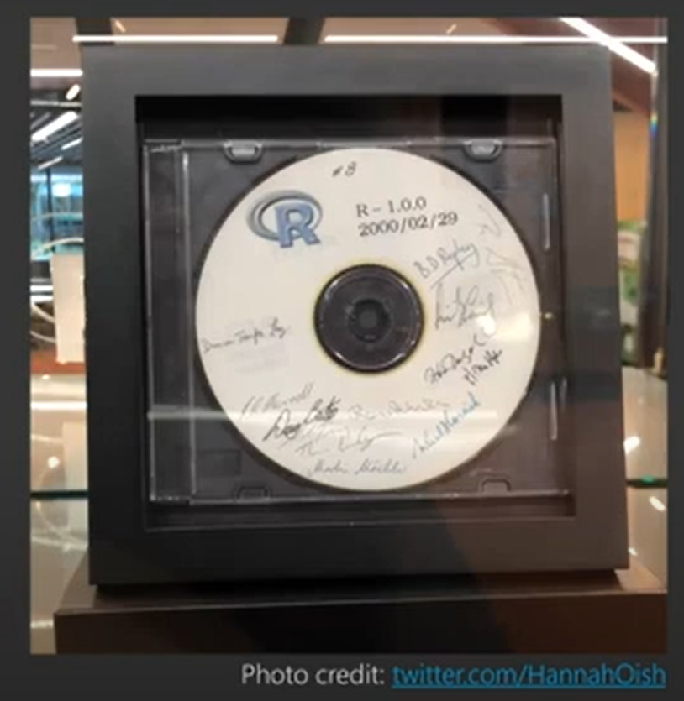
Beginnings of R (2/2)
Figure 8. CD of release 1.0 of R
Notes:
The first major release of R (version 1.0.0) appeared in 2000.
Note: add image source.

Slide 11
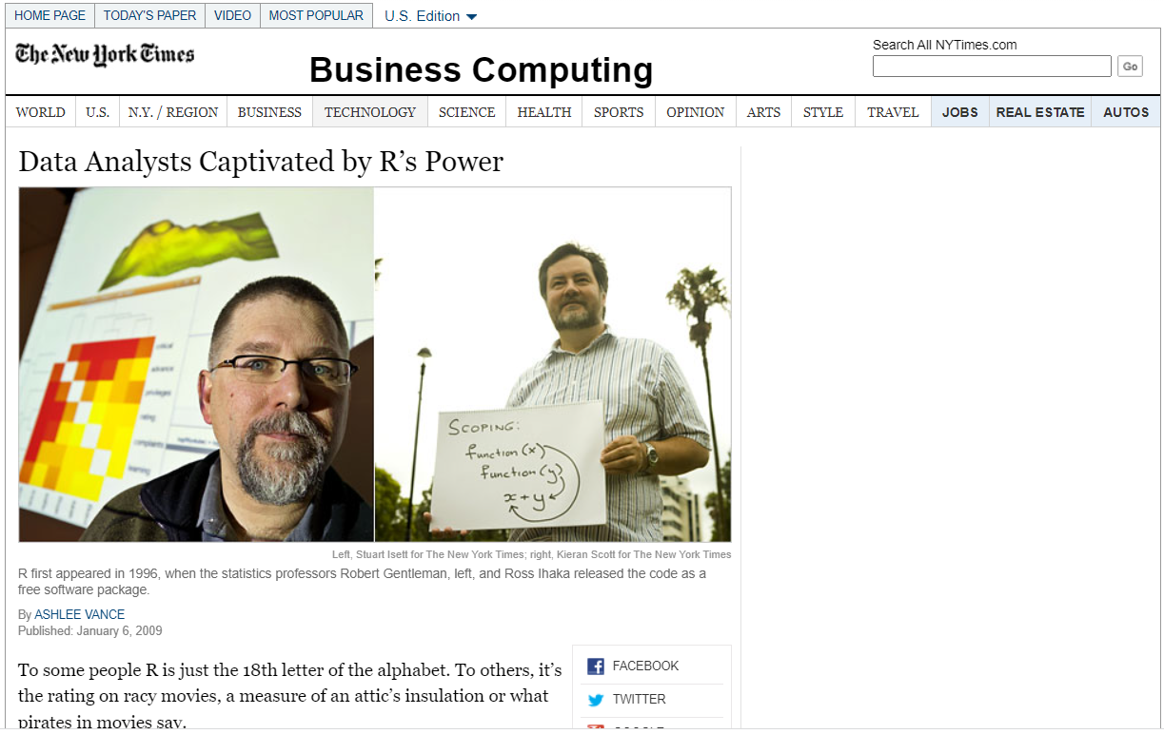
Growth in popularity
Figure 9. Excerpt from New York Times article
Notes:
Soon R eclipsed S+ in popularity. One measure of the breadth of R’s impact was a New York Times article published in 2009.
Ashlee Vance. Data Analysts Captivated by R’s Power. The New York Times, 2009-01-06. Available in html format.

Slide 12
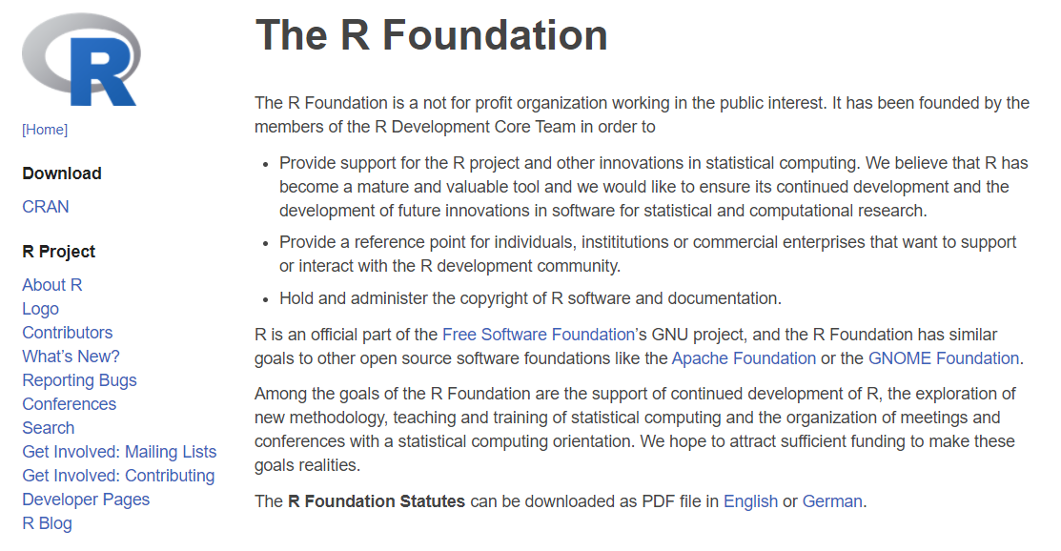
R Foundation
Figure 10. Excerpt from website
Notes:
There is a non-profit group, the R Foundation for Statistical Computing, that coordinates many of the efforts in the maintenance and development of the R programming language.
Note: add image source.

Slide 13
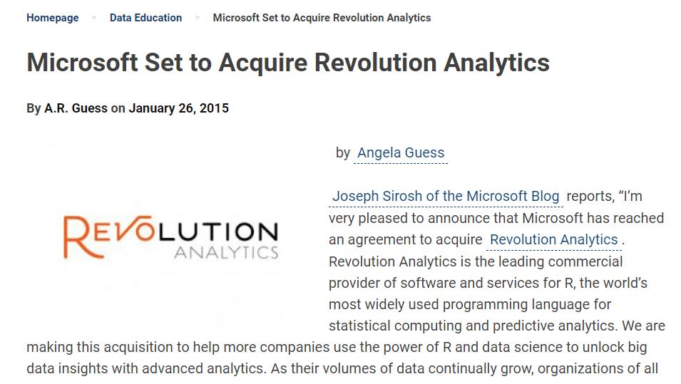
Revolution Analytics
Figure 11. Excerpt from article
Notes:
Several commercial companies have piggybacked on R, including Revolution Analytics, which sells an enhanced version of R with capabilities for handling very large data sets.
Image source: Dataversity
https://www.dataversity.net/microsoft-set-acquire-revolution-analytics/

Slide 14
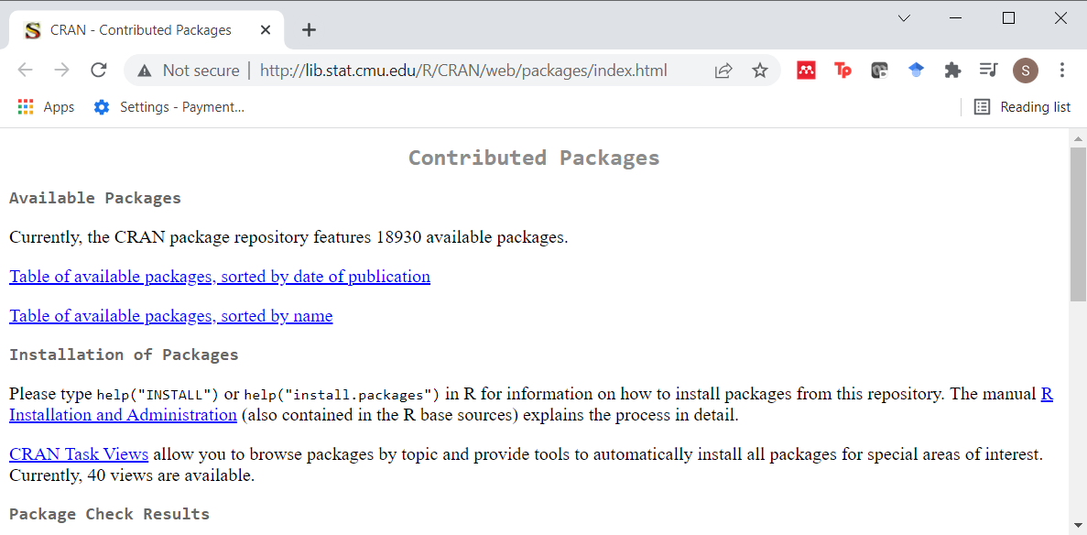
R packages
Figure 12. Excerpt from website
Notes:
One of the most popular features of R is the ease with which outside developers can extend the R language through libraries. Most of these libraries are available for free under and open source license at the Comprehensive R Archive Network.
Image source: Comprehensive R Archive Network

Slide 15

Bioconductor
Figure 13. Excerpt from website
Notes:
You can also find a major effort to develop freely available libraries for statistical analysis of genetic data through the Bioconductor project.
Image source: Bioconductor

Slide 16
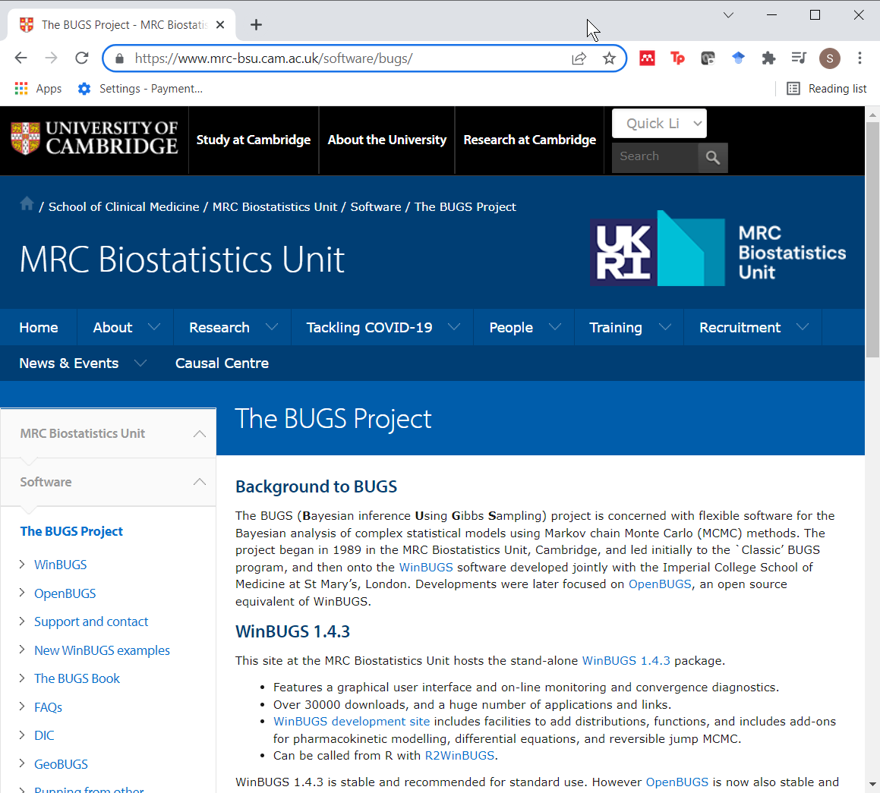
BUGS
Figure 14. Excerpt from website
Notes:
A lot of stand-along programs have leaned heavily on R to provide an interface to run their programs and process their outputs. Notable among these are a series of programs for Bayesian analysis, starting with BUGS. BUGS is an acronym for Bayes Using Gibbs Sampling. While it can be run by itself, it is a lot easier and more convenient to run it from inside R, and most applications of BUGS appear to use R. Other packages, jags (Just Another Gibbls Sampler), and Stan (named after the famous mathematician, Stan Ulam), also rely on R. It is worth noting that these programs are also easily run from Python.
Image source: MRC Biostatistics Unit, University of Cambridge

Slide 17
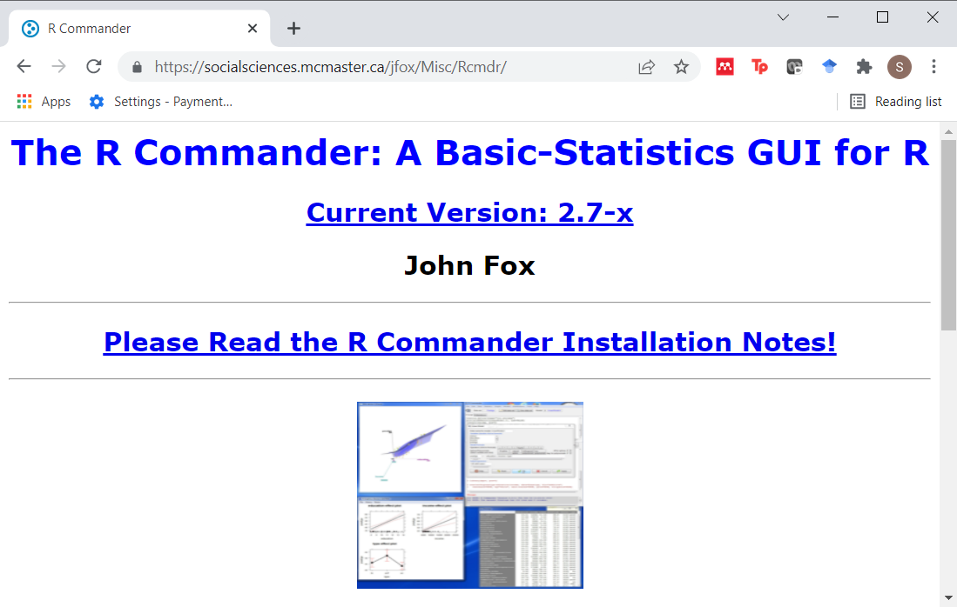
Menu driven version of R
Figure 15. Excerpt from website
Notes:
R is an interactive programming language, but menu driven versions of R are available. The most notable of these is R Commander
Note that this link is currently broken.
Image source: McMaster University

Slide 18
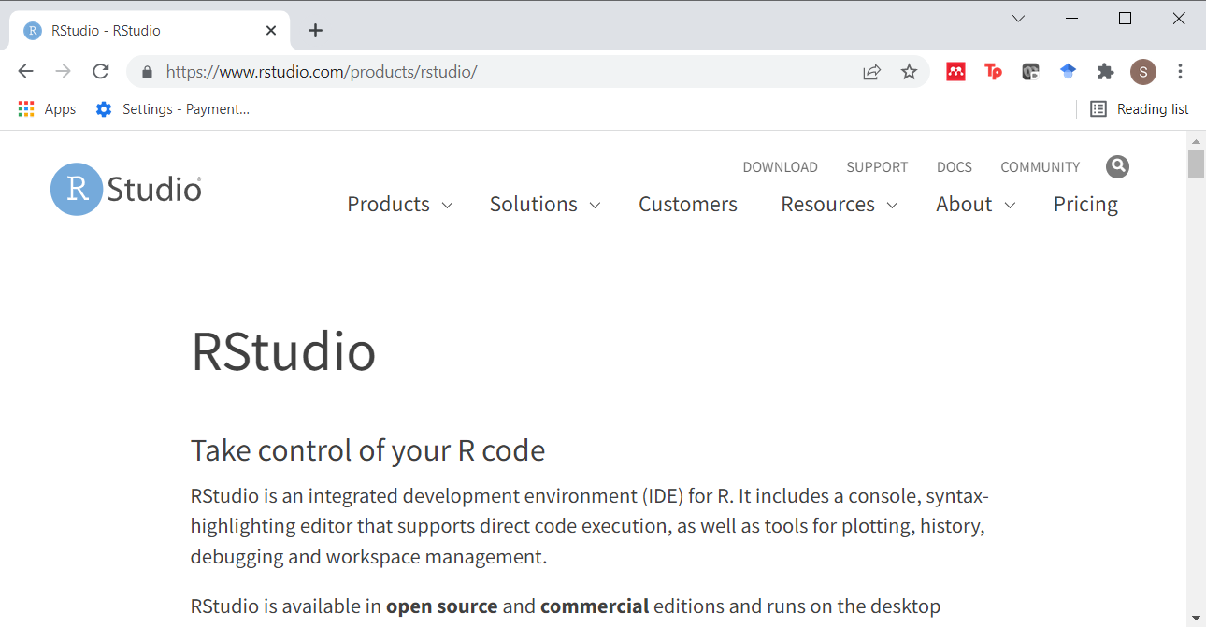
RStudio
Figure 16. Excerpt from website
Notes:
RStudio is an integrated development environment for R, founded somewhere around 2009 to 2011.in 2009. The company that produces RStudio offers both free and commercial versions. They also employ many of the people listed below who have made major contributions to R.
Image source: R Studio (renamed in 2023 to Posit)

Slide 19
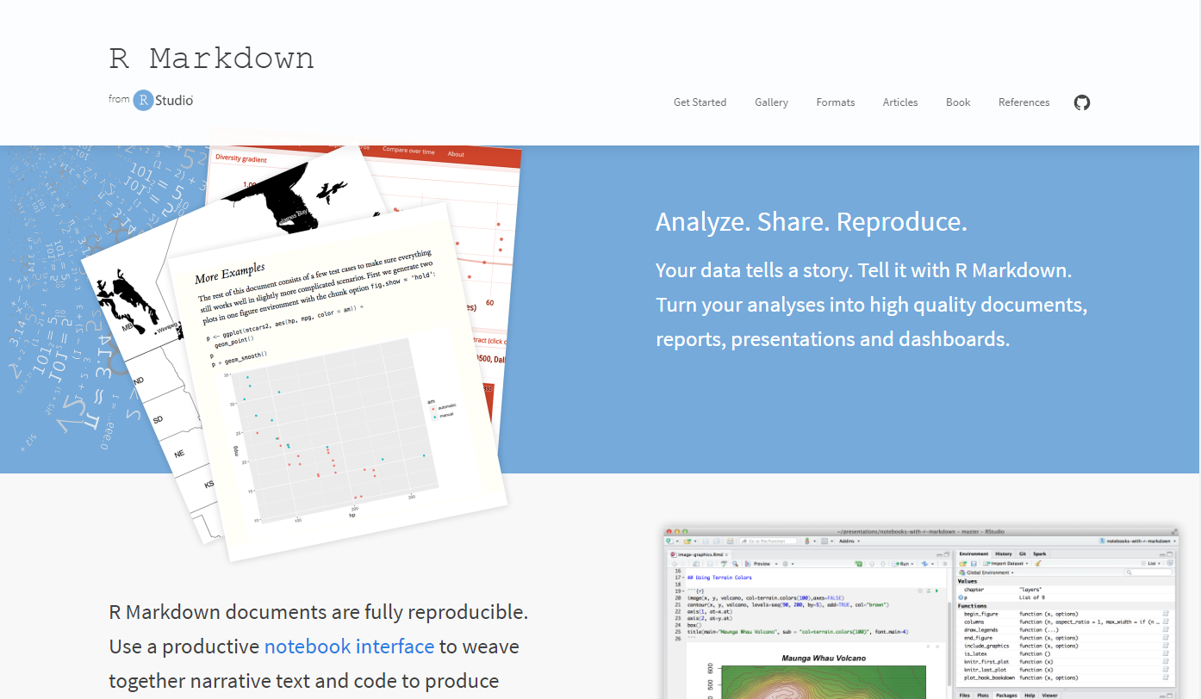
RMarkdown
Figure 17. Excerpt from website
Notes:
RMarkdown is an extension of Markdown syntax. It provides a simple way to denote special formats of text (italics, bold, headings, links, images, bulleted list) and integrate it with code from R, Python, and other software. RMarkdown uses Pandoc, a program that produces output in a variety of formats: html, Latex, Microsoft Word, Microsoft PowerPoint, PDF, and others.
Image source: RStudio

Slide 20

Recent major contributions: Frank Harrell
Figure 18. Title slide from Frank Harrell talk
Notes:
Frank Harrell has produced a lot of advanced statistical models for R. This includes some extremely useful spline tools. His book, Regression Modeling Strategies, a classic text, uses R code throughout.
Image source: R-bloggers

Slide 21

Recent major contributions: Hadley Wickham
Figure 19. Title slide from presentation
Notes:
Hadley Wickham has written or co-written a large number of libraries in R that have refashioned R into almost a completely new programming language. He was hired by RStudio in 2012 and has been a driving force behind almost all of the development in that company.
Image source: Data Science, College of Science, University of Notre Dame

Slide 22
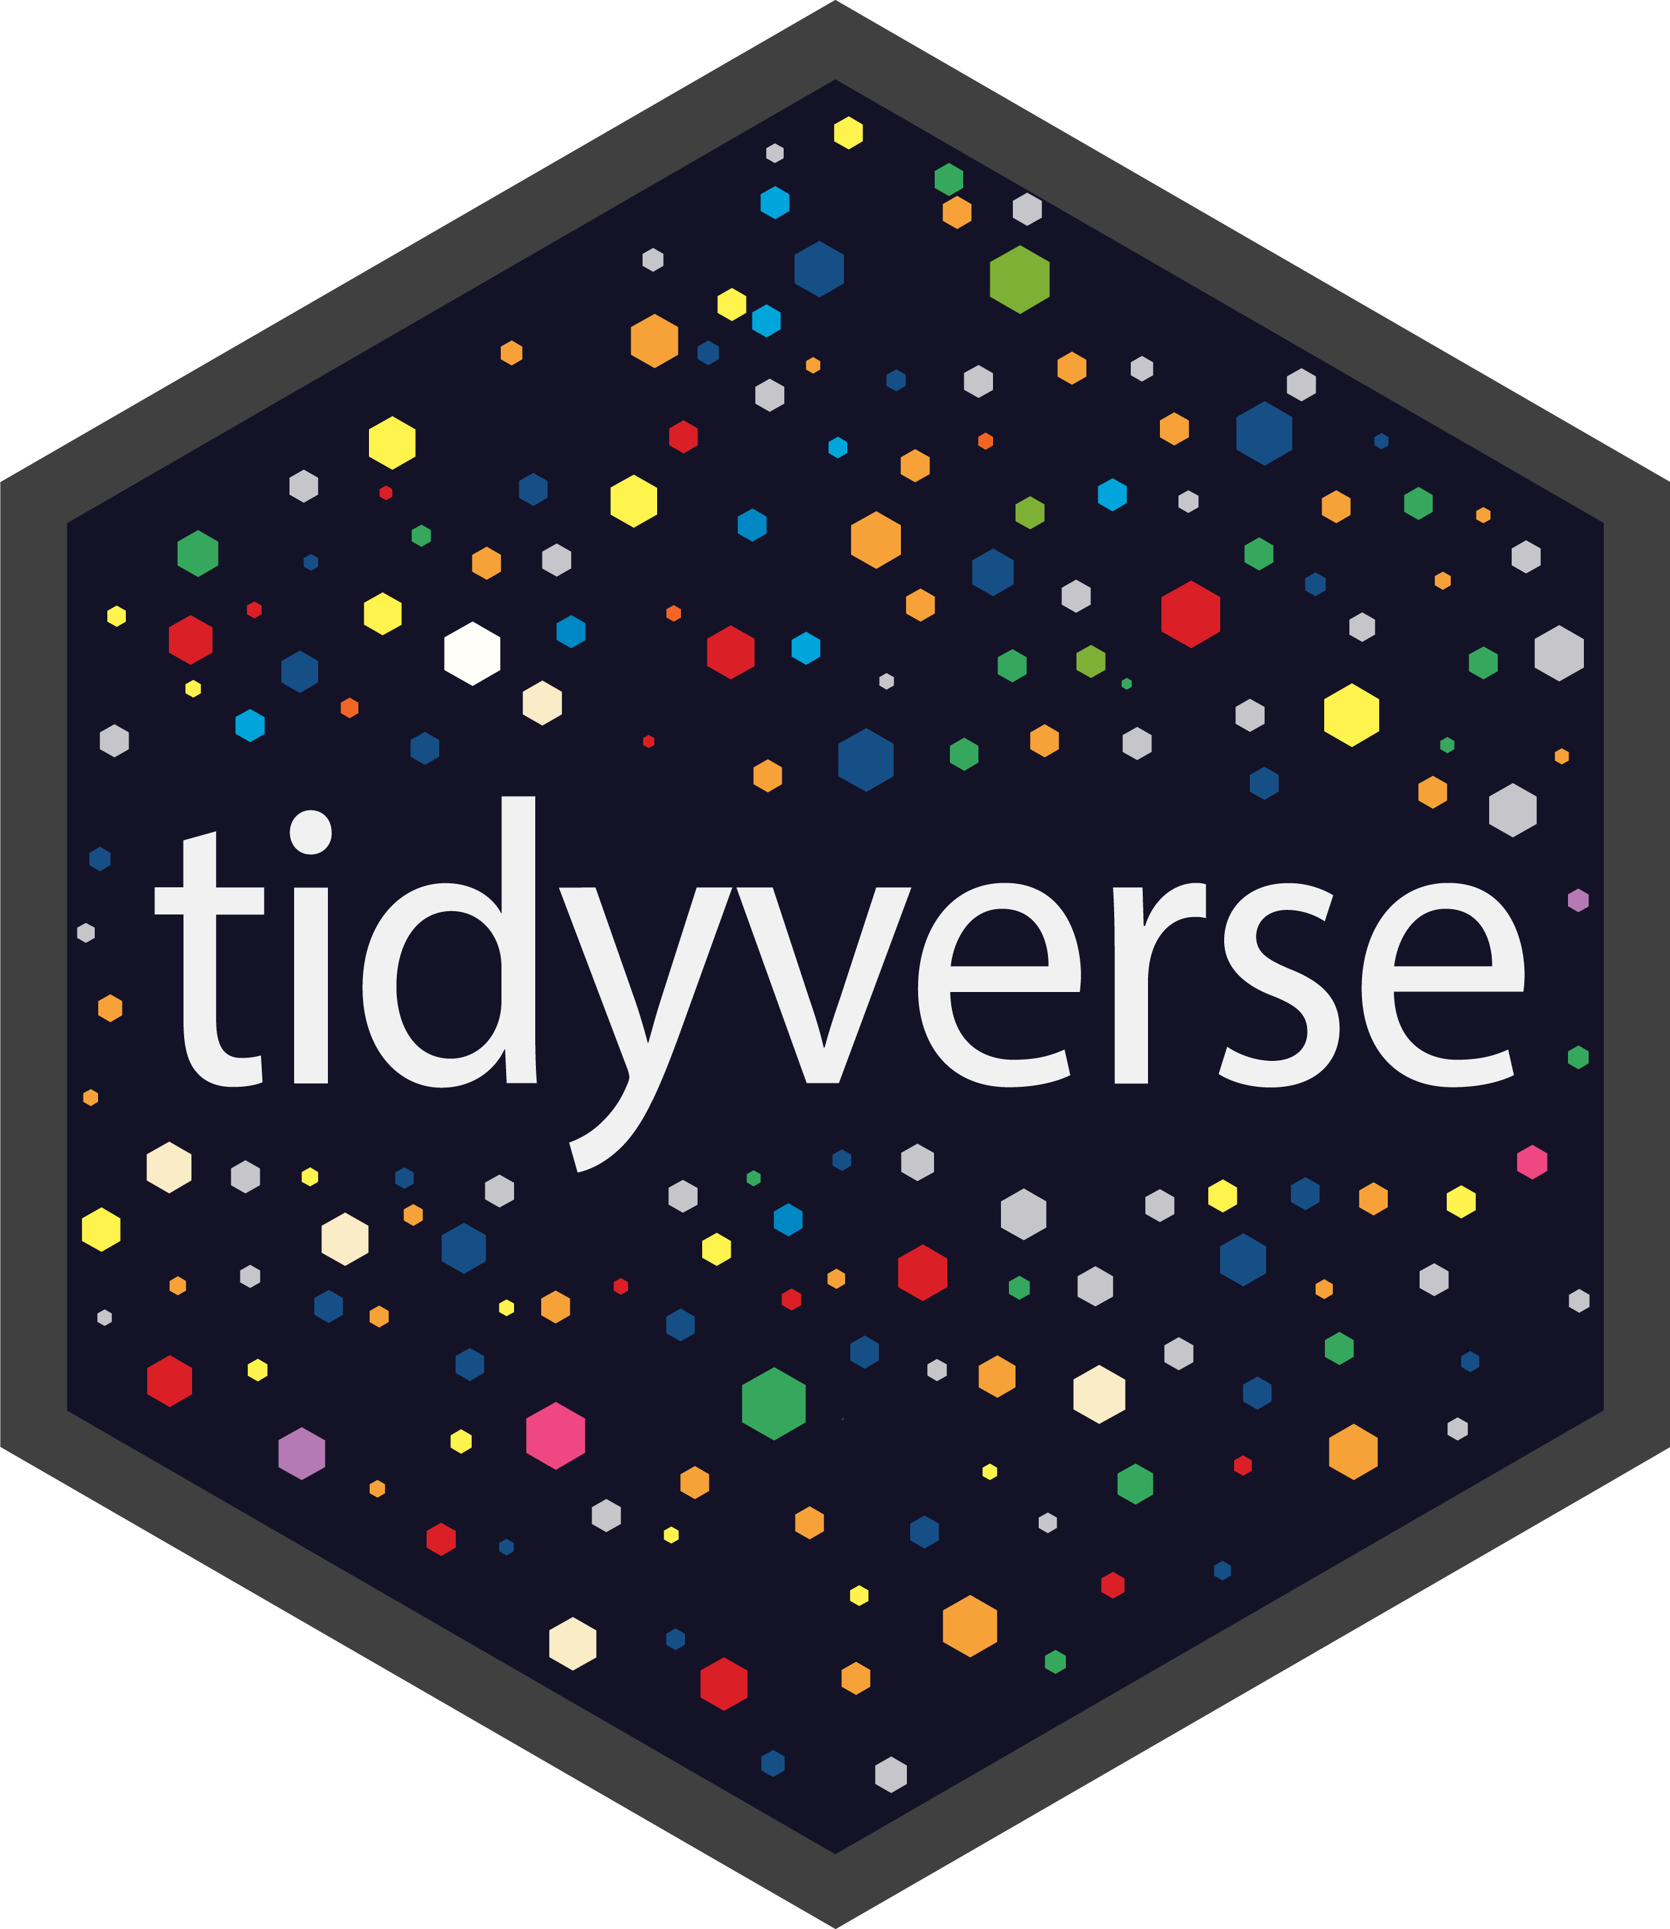
The tidyverse library
Figure 20. Hex sticker for tidyverse
Notes:
Originally, these packages were referred to collectively as the “Hadleyverse.” But Hadley Wickham discouraged that in favor of the name “tidyverse.”
The tidyverse package is a collection of several different packages which provide enhancements to the R programming language. These libraries share a common programming philosophy. There are several dozen libraries in total, but only a core set of libraries are loaded with the library(tidyverse) function. Other tidyverse packages must be loaded separately.
The tidyverse is a collection of packages for the R programming language developed by Hadley Wickham and others. I single out Hadley Wickham because he has been a major force behind the programming philosophy of the tidyverse and the lead author for many of the most important packages in the tidyverse.
The tidyverse packages embrace some guiding principles described in the tidyverse manifesto. The packages in the tidyverse encourage the use of tidy data. Tidy data is related to the database concept of normalization, though it is described from a statistical perspective (which means that an idiot like me can still understand it). The general concepts behind tidy data are described in a vignette and in a 2014 publication in the Journal of Statistical Software. The tidyverse research team has published a detailed guides on coding practices and program style that are consistent with their principles.
Here are some of the libraries in core set of libraries.
Image source: RStudio github

Slide 23

dplyr
Figure 21. Hex sticker for dplyr
Notes:
dplyr provides a set of functions for data manipulation.
Image source: RStudio github

Slide 24
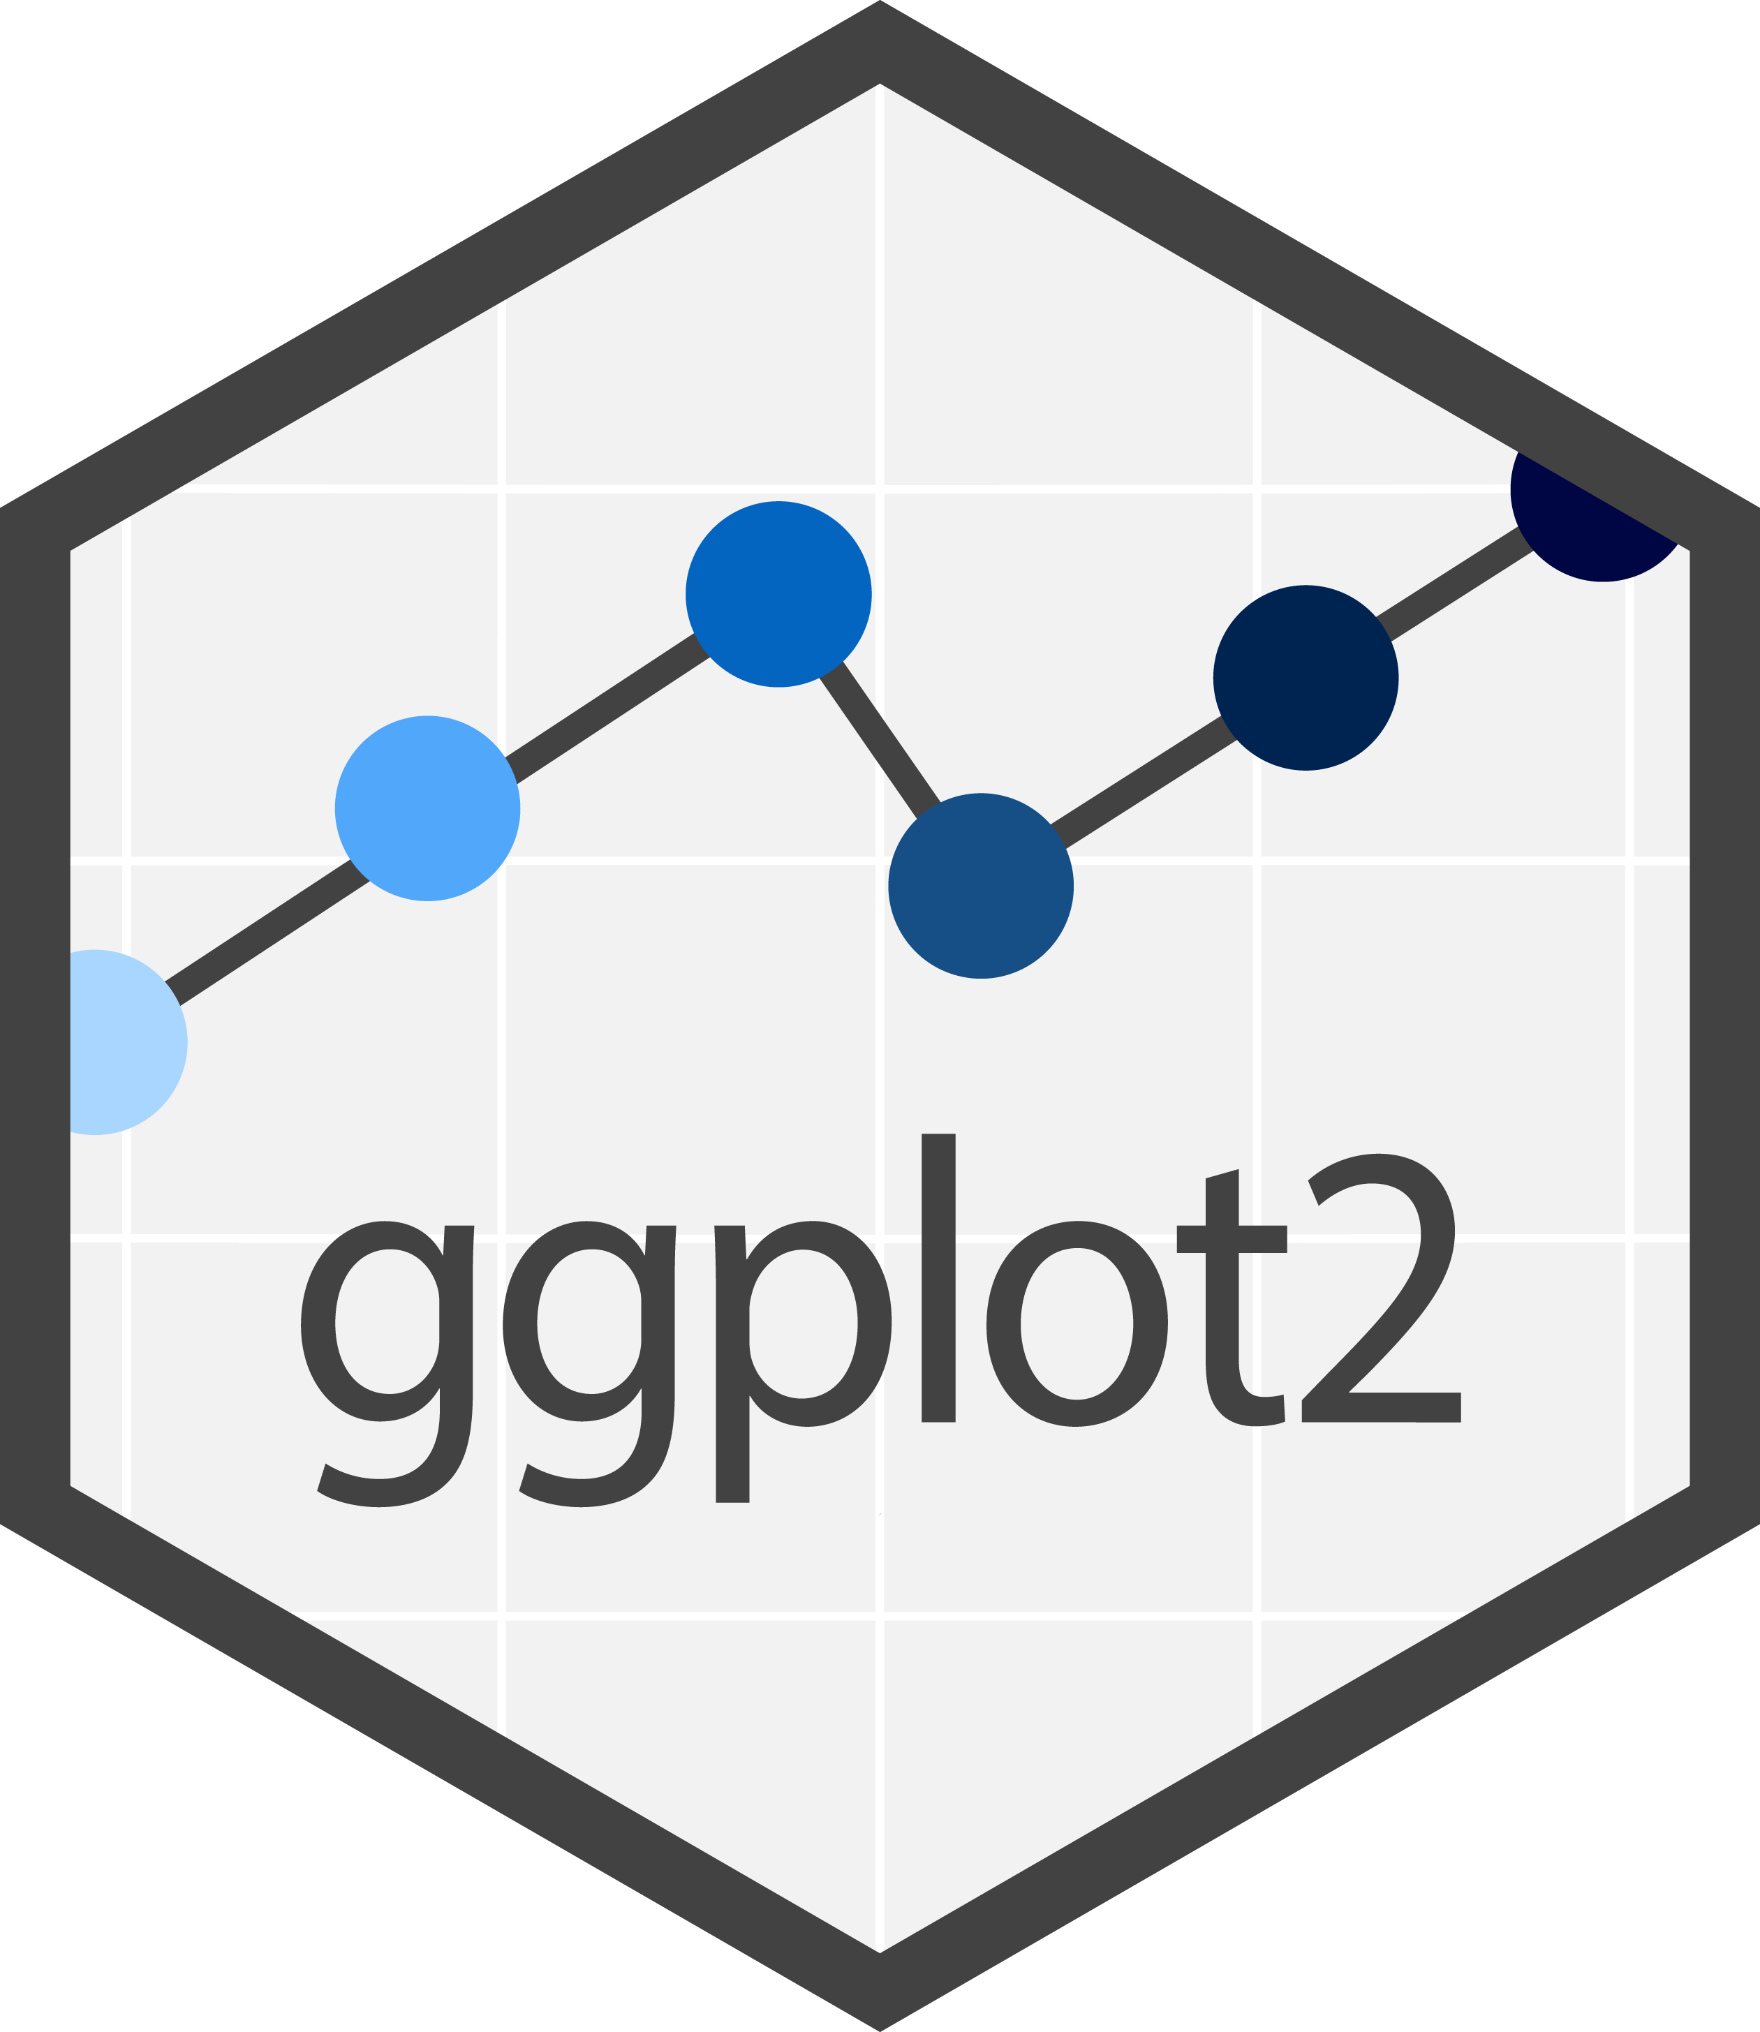
ggplot2
Figure 22. Hex sticker for ggplot2
Notes:
While R has some excellent graphics capabilities built in, they are somewhat difficult to use. The ggplot2 library simplifies the process of graphing by separating the parts of a graph into different layers. It is based on a conceptual framework developed by Leland Wilkinson in his book, The Grammar of Graphics.
Image source: RStudio github

Slide 25
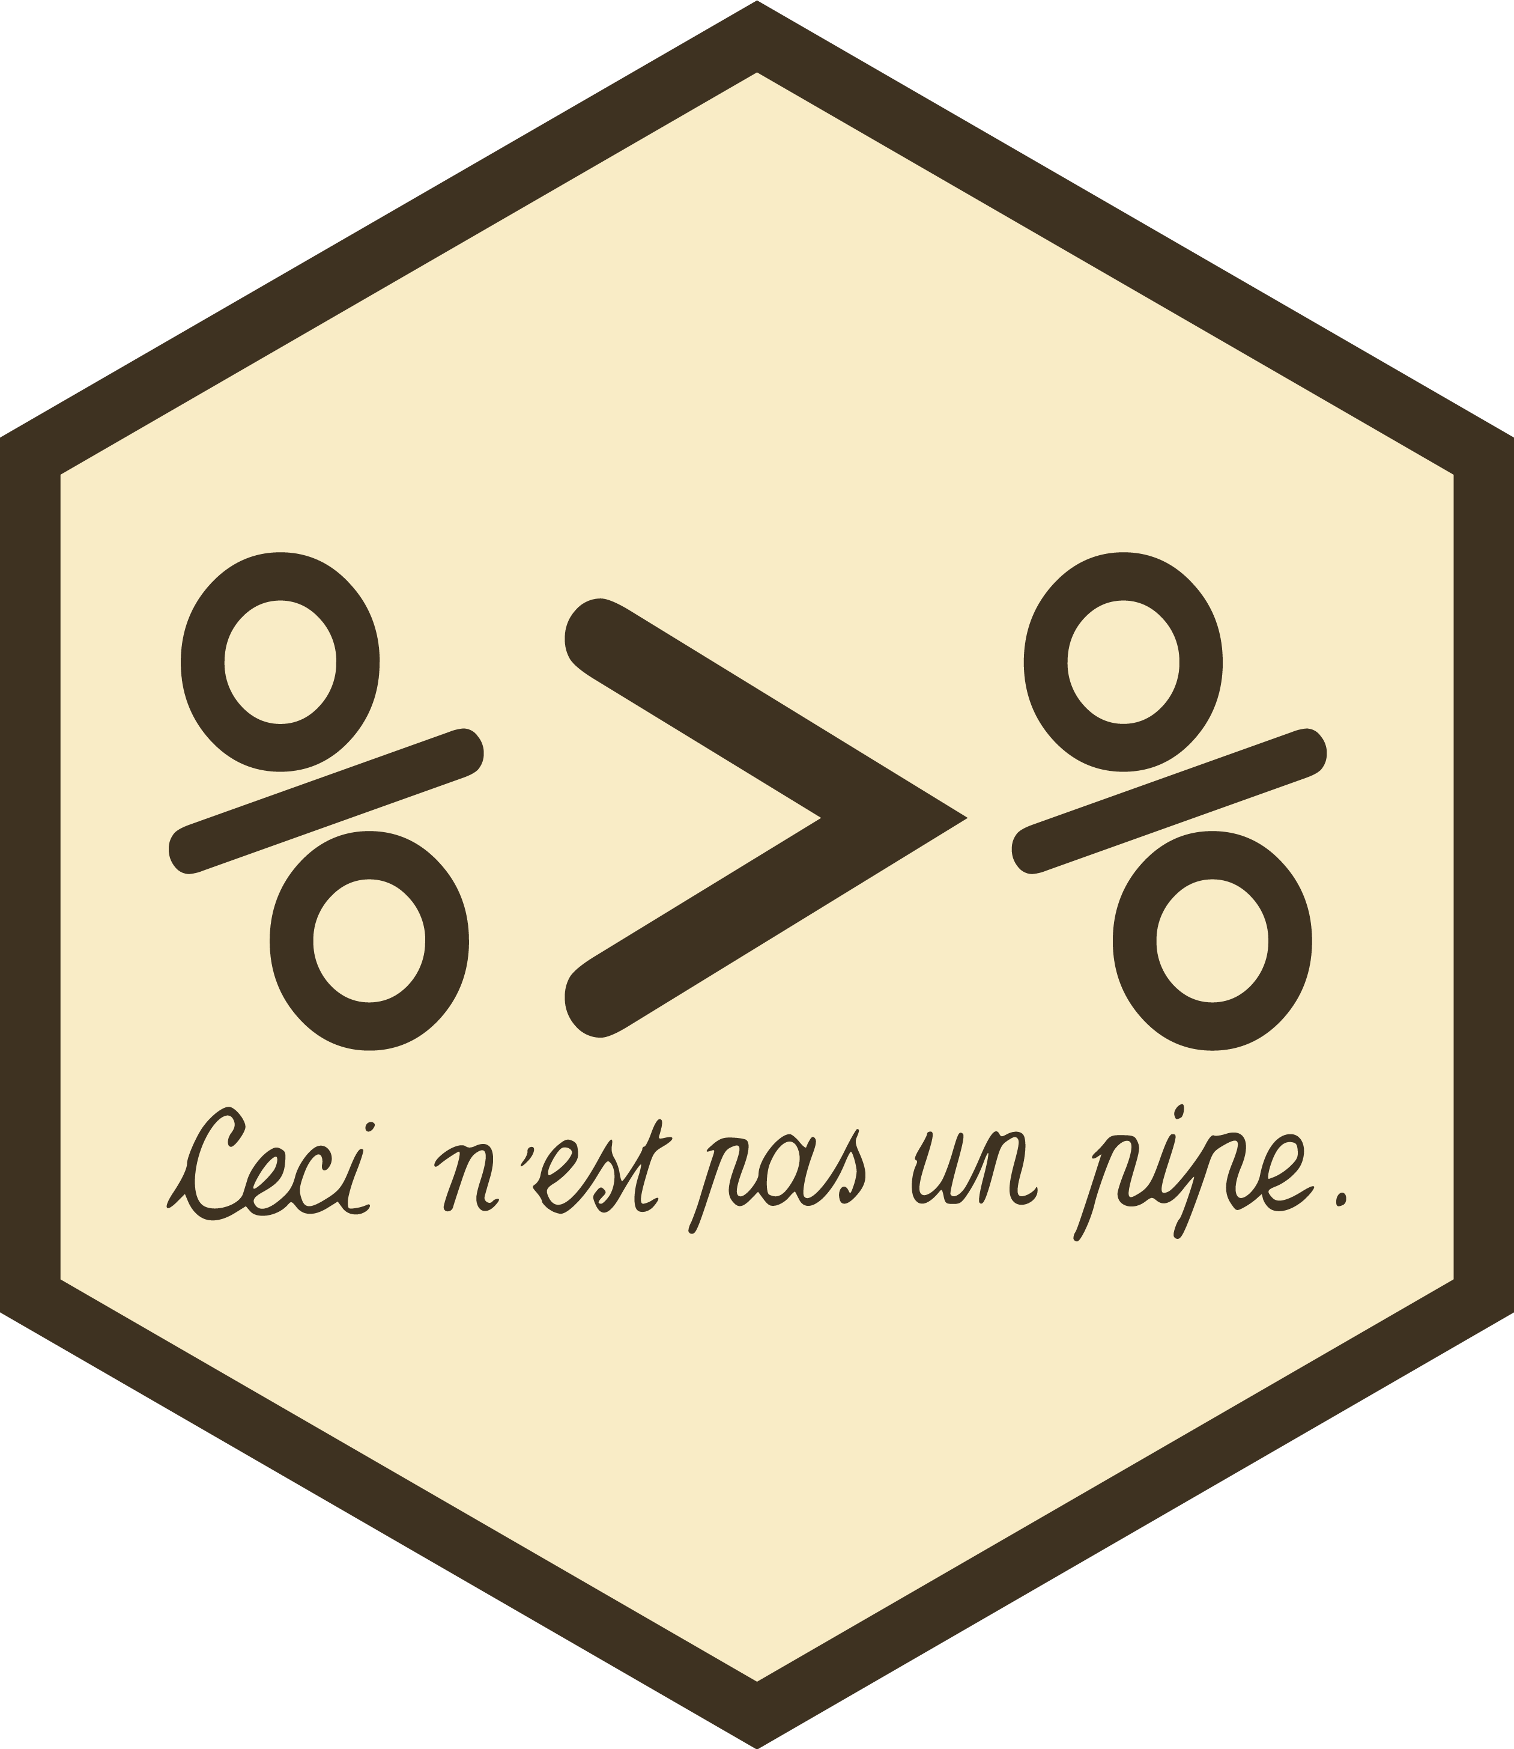
magrittr
Figure 23. Hex sticker for magrittr
Notes:
magrittr provides a pipe operator. The concept of the pipe was developed first in Unix systems almost 50 years ago. The pipe operator (percent-greater than-percent) takes input from the left side of the operator and feeds it to a function listed on the right side of the operator. Pipes can be chained together. They make your code simpler and more readable.
We may or may not cover pipes in this class.
Image source: RStudio github

Slide 26

readr
Figure 24. Hex sticker for readr
Notes:
While R has many functions for reading text data, they are slow for very large files. The readr library reads text files much faster, offers some enhancements, and provides a simpler syntax.
Image source: RStudio github

Slide 27

stringr
Figure 25. Hex sticker for stingr
Notes:
stringr simplifies the manipulation of string or text data.
Image source: RStudio github

Slide 28
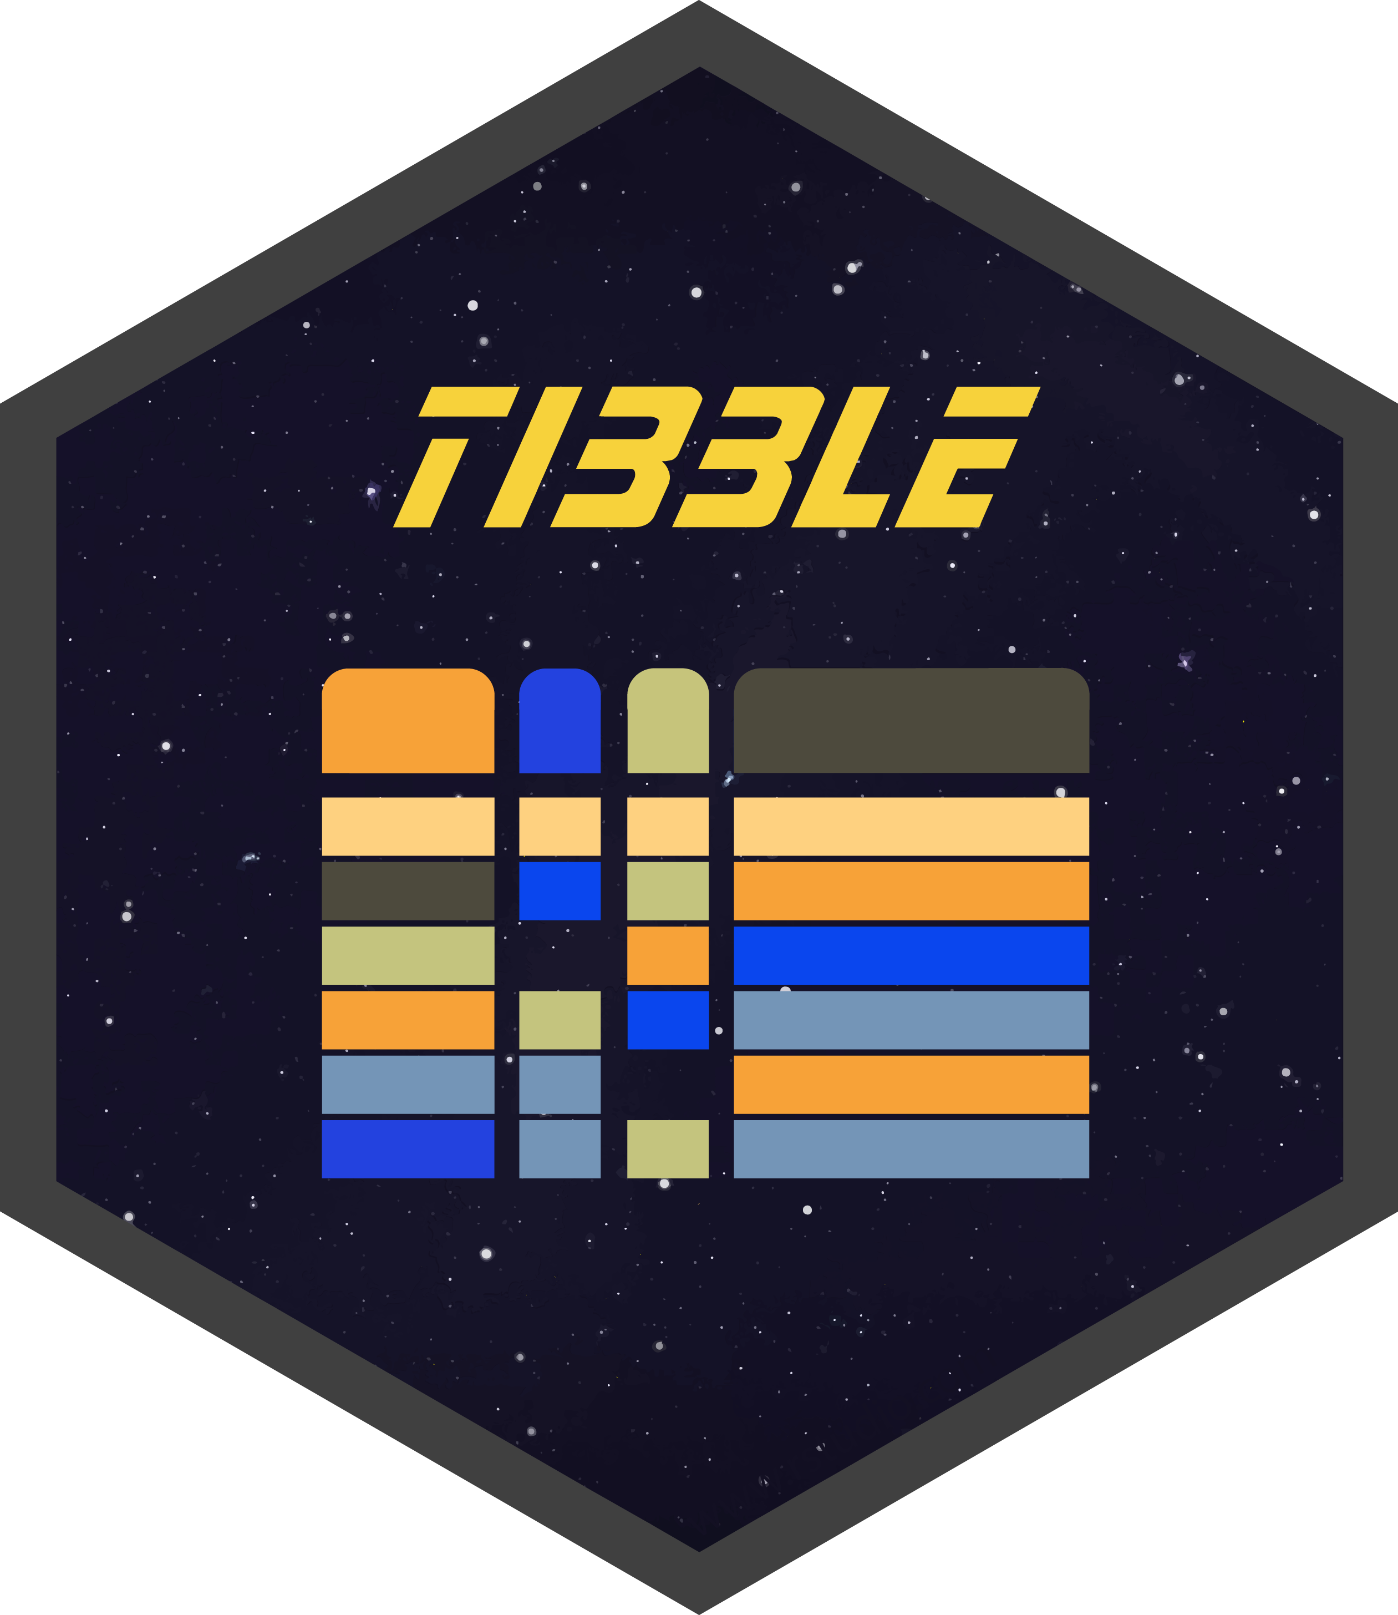
tibble
Figure 26. Hex sticker for tibble
Notes:
R has a variety of internal storage formats: arrays, lists, matrices, and data frames. We will focus mostly on data frames in this class. The tibble package offers an internal storage format, a tibble, that is very similar to a data frame, but it offers some extra features for convenience and simplicity.
Image source: RStudio github

Slide 29

tidyr
Figure 27. Hex sticker for tidyr
Notes:
tidyr provides a series of functions that help with data manipulation, especially for longitudinal data.
Image source: RStudio github

Slide 30
Other packages in the tidyverse
In the core package
forcats
purr
Outside the core package
broom
lubridate
readxl
many others
Notes:
Two other packages in the tidyverse core, forcats and purr, are for advanced applications.
Outside of the core package, some of the packages that I like are broom (which simplifies and standardizes the output from different data analysis functions) lubridate (which simplifies the manipulaton of dates), and readxl (which reads Microsoft Excel files). There are quite a few others.

Slide 31
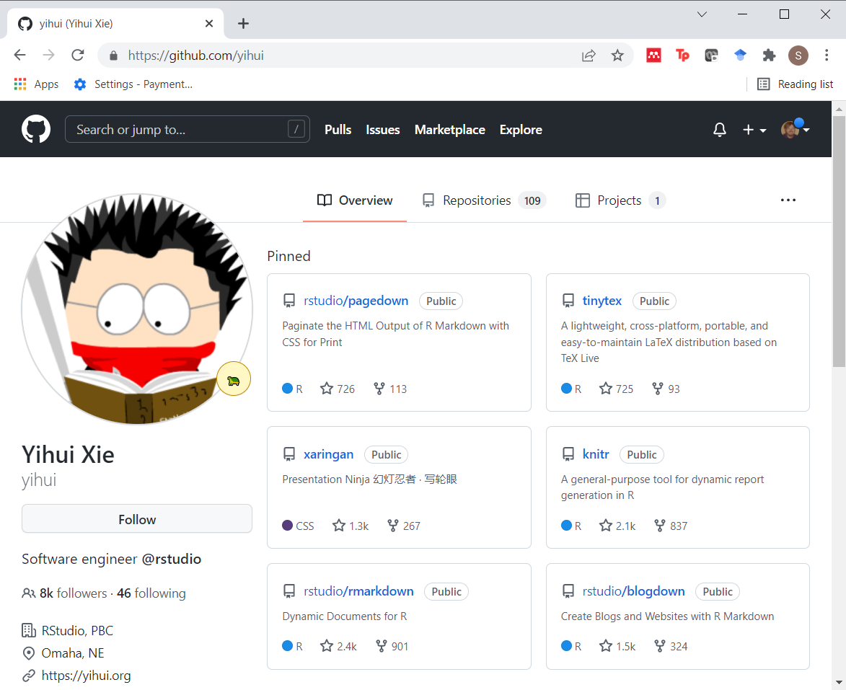
Recent major contributions: Yihui Xie
Figure 28. Exceprt from github site
Notes:
Another prolific contributor to R is Yihui Xie. He was an employee of Rstudio from 2013 through 2023, but was laid off as part of the transition to Posit (see below).
Image source: Yihui Xie github

Slide 32

knitr
Figure 29. Hex sticker for knitr
Notes:
He wrote the package knitr back in 2012 that has revolutionized the field of reproducible research. knitr is an improvement on the package sweave. It takes R code, runs it and creates documents in a variety of formats using Pandoc.
Image source: RStudio github

Slide 33

bookdown
Figure 30. Hex sticker for bookdown
Notes:
He wrote also wrote a package, bookdown, that has revolutionized the book publishing world. You can now write an entire book in R with the help of this package. It has publication ready graphics, tables, and formulas. It produces the table of contents, and an index. Over a thousand books have been produced using bookdown, including the definitive guide to bookdown itself, bookdown: Authoring Books and Technical Documents with R Markdown by Yihui Xie.
Image source: RStudio github

Slide 34
Other works by Yihui Xie
blogdown
tinytex
xaringan
Notes:
There are a lot more works by Yihui Xie that are worth discussing. blogdown uses R Markdown code to create a blog site. It is based on an open source web development system called Hugo. I am currently trying to convert my website (over 1,800 pages) to blogdown.
tinytex is an attempt to develop a minimal package for producing LaTex documents. It has all the features that you need to work with R Markdown, but does not include some of the extra features found in other versions of LaTex, that needlessly (in his opinion) add to the complexity of using LaTeX as part of R Markdown.
xaringan is a presentation format using html that offers an alternative to beamer and slidy.

Slide 35
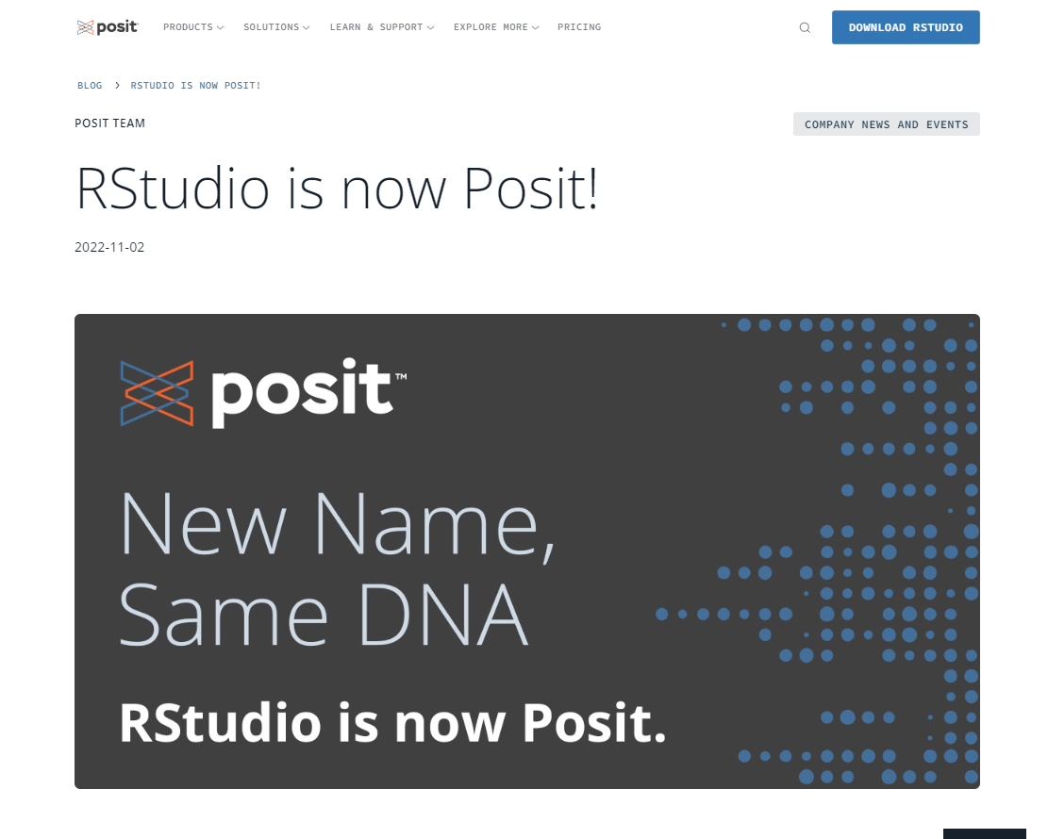
RStudio renamed as Posit
Figure 31. Excerpt from Posit blog
Notes:
In 2022, the company that produces RStudio renamed itself from RStudio to Posit. They felt that the name RStudio was focused just on R and they wanted to branch out with a broader focus to a larger community. In particular, they wanted to attract users of Python and users of Jupyter notebooks.
One major personnel shifts during the transition was the hiring of Wes McKinney, creator of the pandas package for Python. Another was the layoff of Yihui Xie, described above.
Image source: Posit blog

Slide 36

Quarto
Figure 32. Hex sticker for Quarto
Notes:
One of the first packages announced by the new Posit company was Quarto. Quarto is an alternative to RMarkdown. While RMarkdown requires that you install R prior to use, Quarto does not. It is part of the broadening strategy of Posit and opens up the features of RMarkdown to those who prefer to use only Python on their systems. It also opens up the features of RMarkdown to those who prefer to use only Jupyter on their systems.
Posit will continue to maintain RMarkdown for the forseeable future. New features, however, will be added to Quarto and only ported over to RMarkdown if it can be done easily. So you should adopt Quarto if you want to be on the cutting edge. Any files written using RMarkdown will work with Quarto, so the transition, if you are a seasoned user of RMarkdown is easy. The reverse is not necessarily true. There are a few features in Quarto (not too many, at least in 2024) that will not work with RMarkdown.
Image source: RStudio github

Slide 37
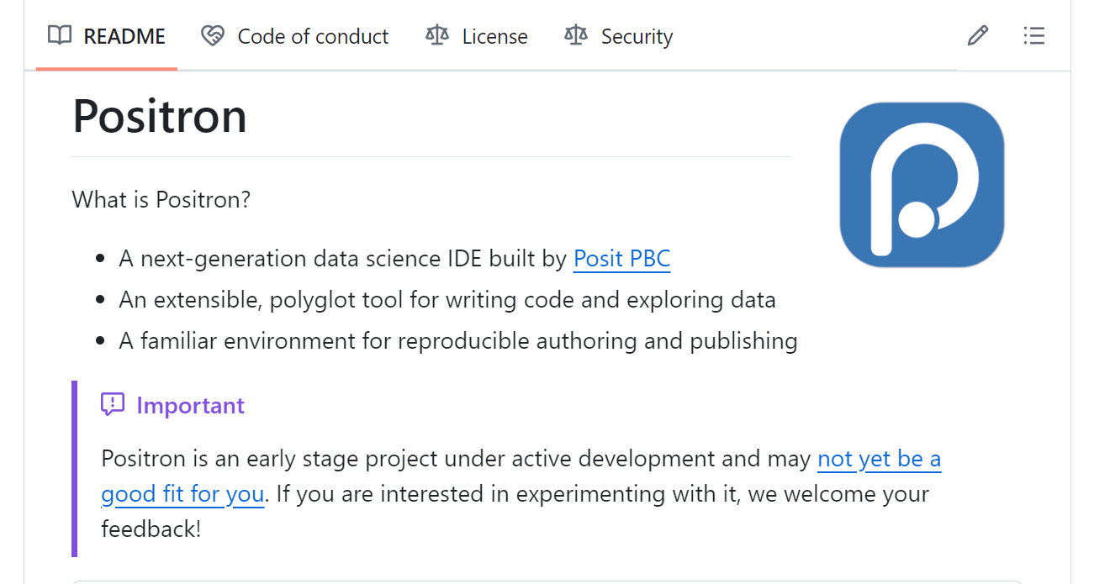
Positron
Figure 33. Excerpt from README file
Notes:
A new integrated development environment, Positron, is currently (2004) in the beta testing phase. It is intended as an eventual replacement for RStudio, but I would not recommend making the transition to Positron just yet.
Positron is another part of the broadening strategy of Posit. While it allows you to run Python code, RMarkdown is built on a foundation of R. Positron, based on CODE OSS, uses the same basic integrated development environment as Microsoft Visual Studio. You can use it on a machine that only has Python installed or a machine that only has R installed. Don’t try it on a machine that has neither installed, at least not yet. A big advantage of decoupling from R is that Positron will not crash when R (or Python) crashes. it also allows you to use extensions developed for Microsoft Visual Studio.
Image source: posit-dev github

Slide 38
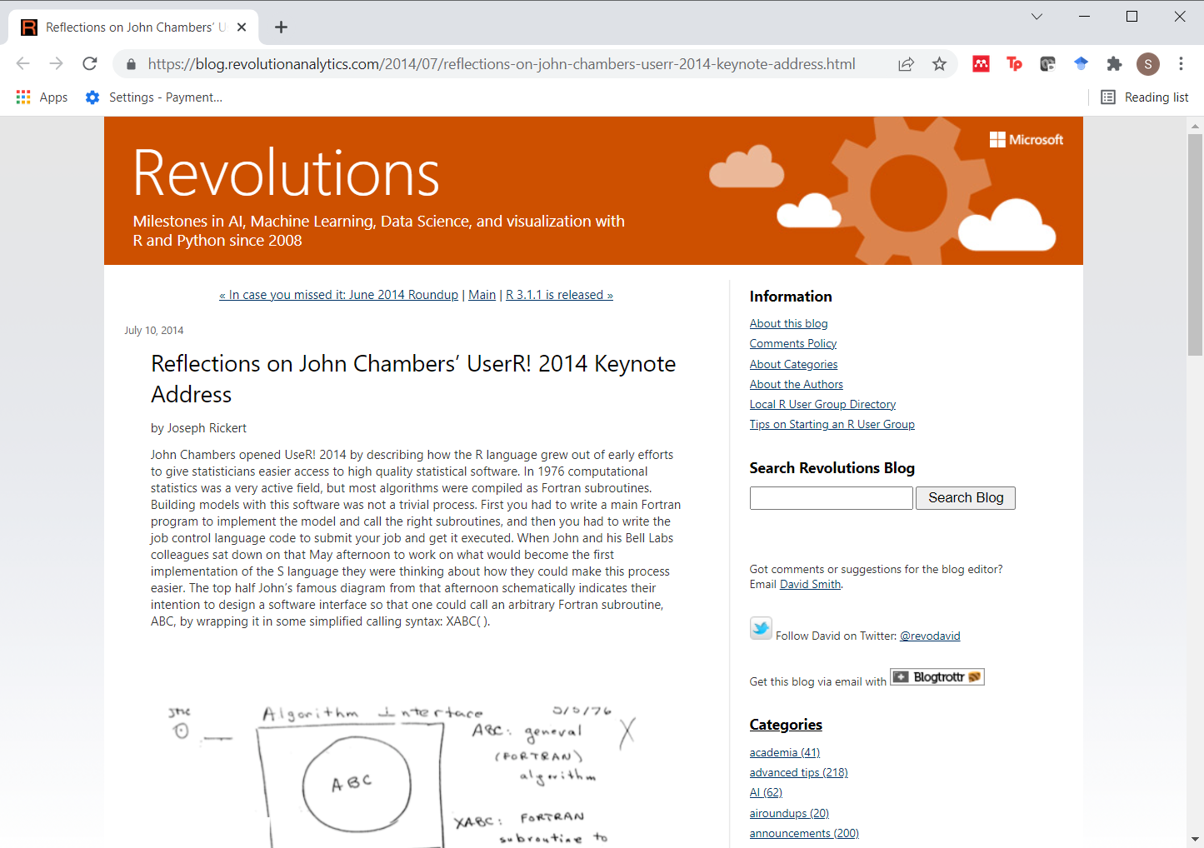
If you want to learn more: Rickert 2014
Figure 34. Excerpt from blog post
Notes:
The Revolutions Analytic blog posted a nice summary of a John Chambers talk on the history of S at the Use R! 2014 conference

Slide 39
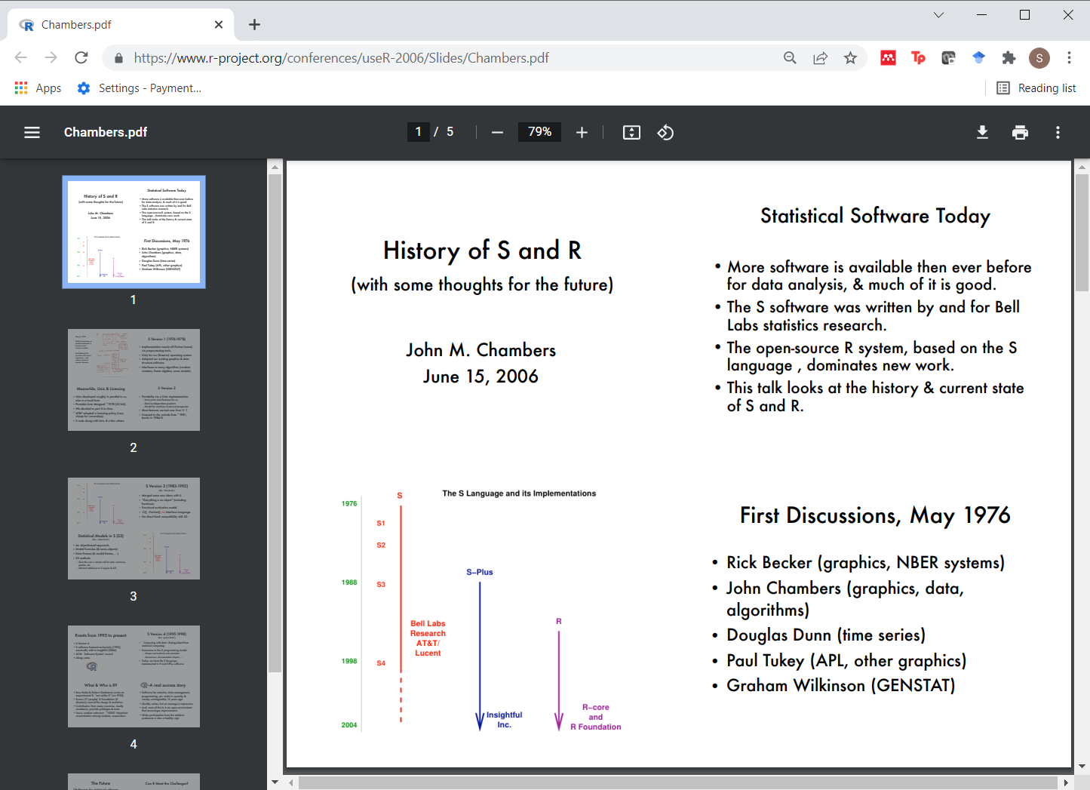
If you want to learn more: Chambers 2006
Figure 35. Title slide from presentation
Notes:
That article has links to the slides (PDF format) of a 2006 talk (again on the history of S) by John Chambers.

Slide 40
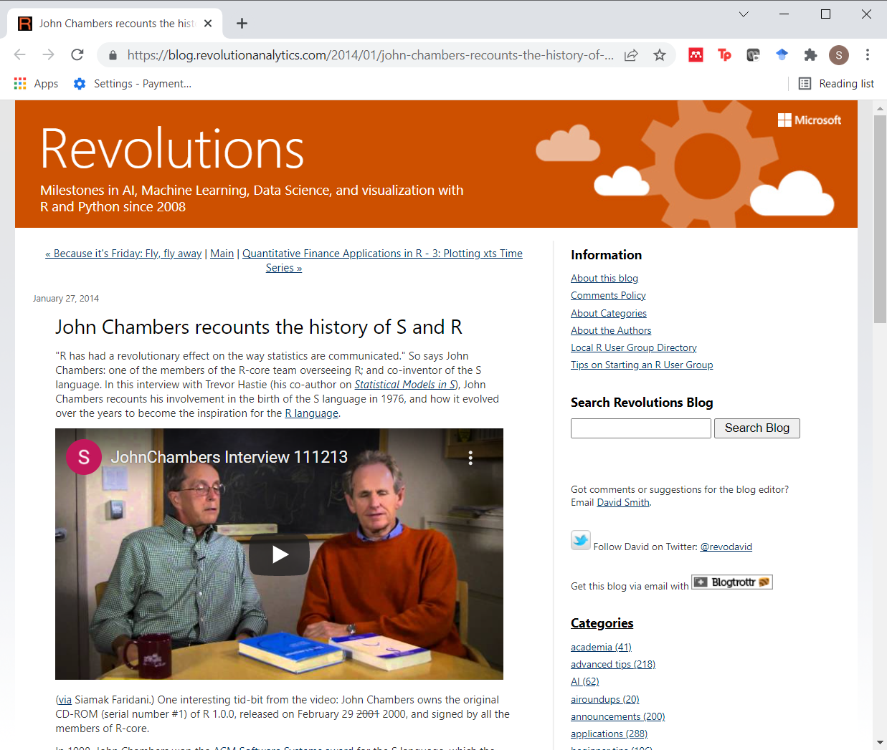
If you want to learn more: Hastie 2014
Figure 36. Excerpt from blog post
Notes:
as well as a video interview of John Chambers by Trevor Hastie.

Slide 41
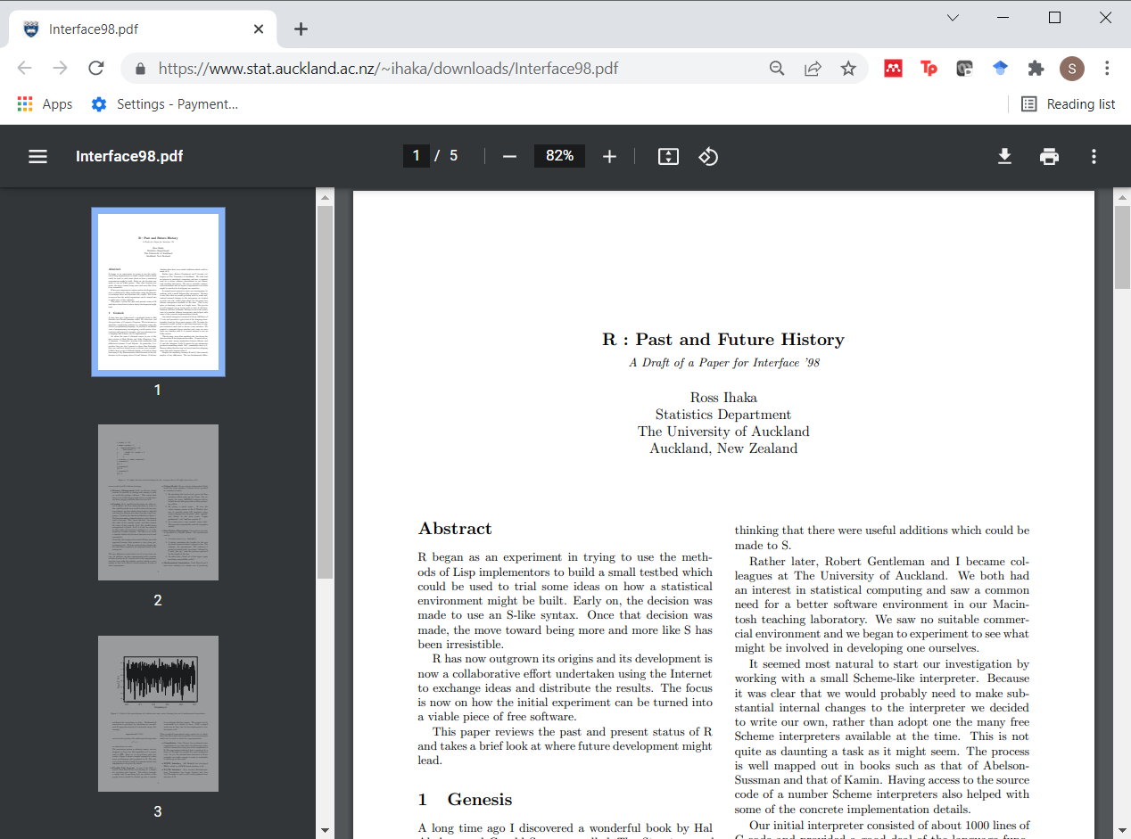
If you want to learn more: Ihaka 1998
Figure 37. Excerpt from research paper
Notes:
and a 1998 paper (PDF format) by Ross Ihaka on the past (!) and future of R presented at the Interface conference.

Slide 42
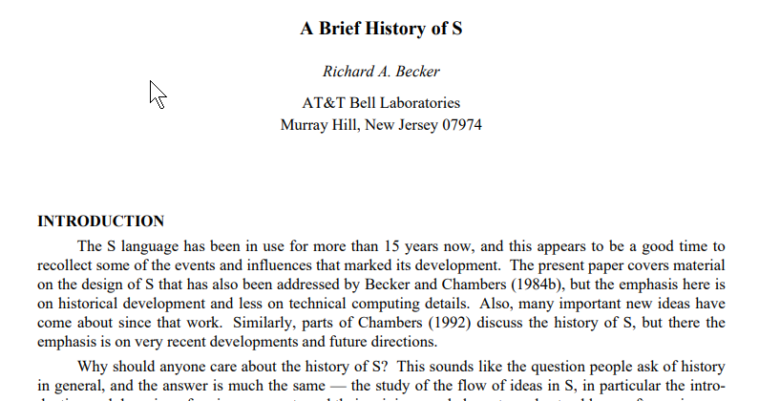
If you want to learn more: Becker (no date)
Figure 38. Excerpt from paper
Notes:
Richard Beckman. A Brief History of S. Available in pdf format

Slide 43
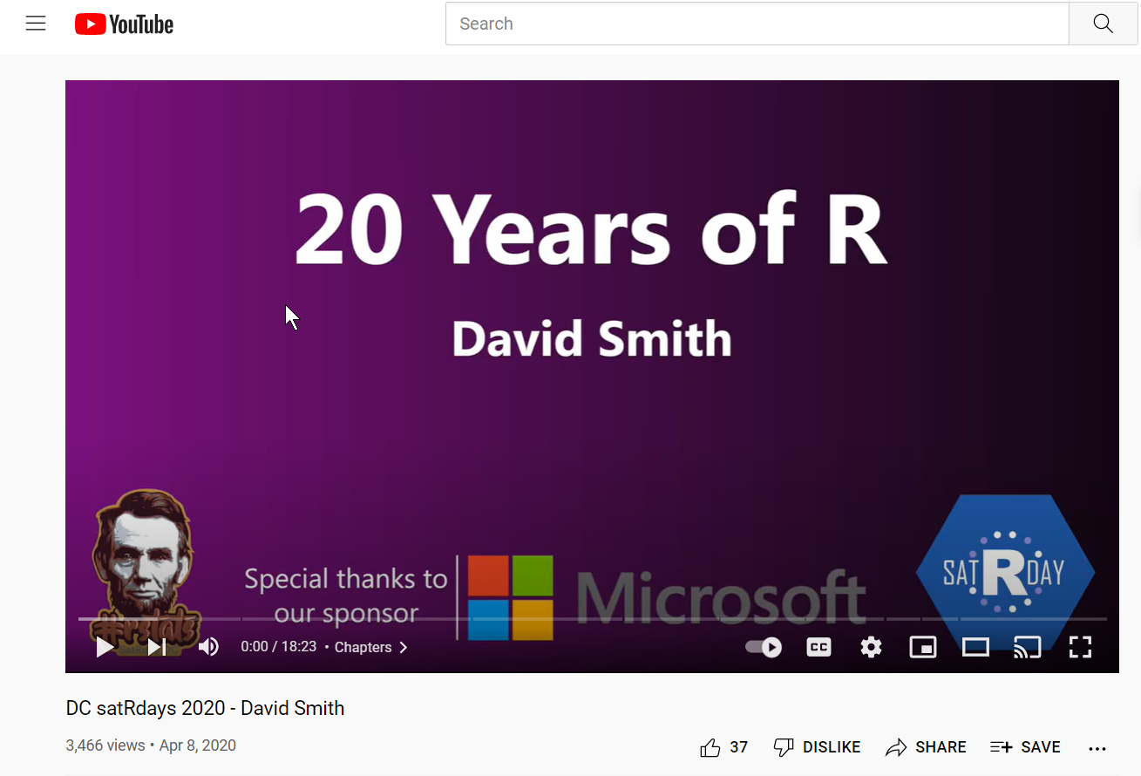
If you want to learn more: Smith 2020
Figure 39. Excerpt from website
Notes:
David Smith, 20 years of R, presented at DC satRdays. Available as a YouTube video
You can find an earlier version of this page on my blog.

